Slide 1
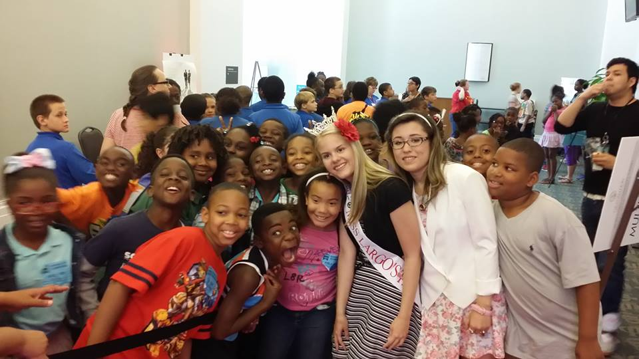
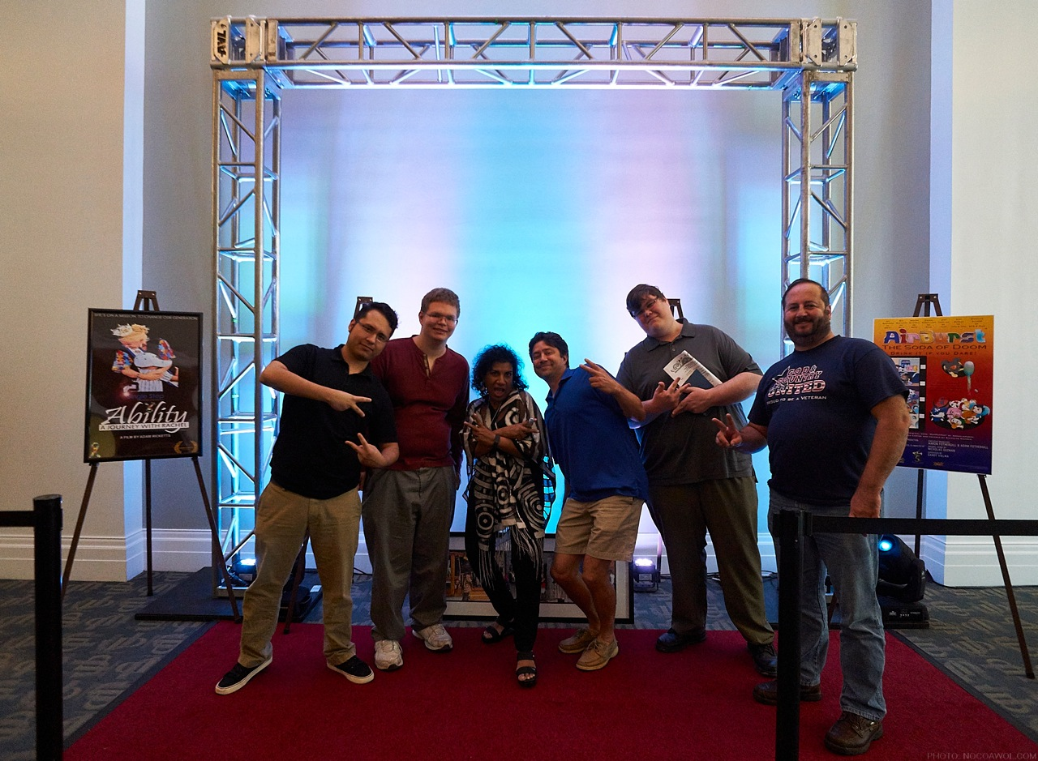
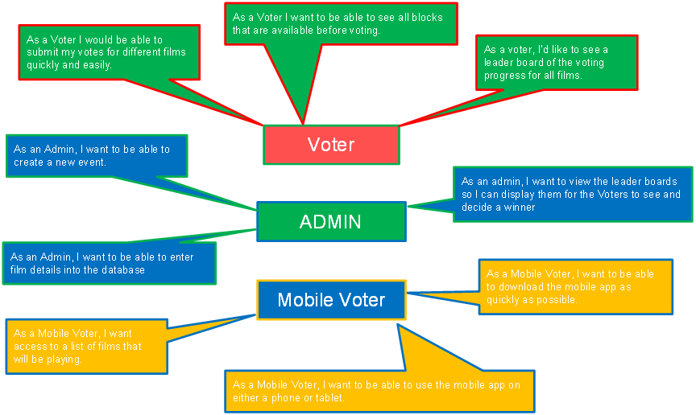
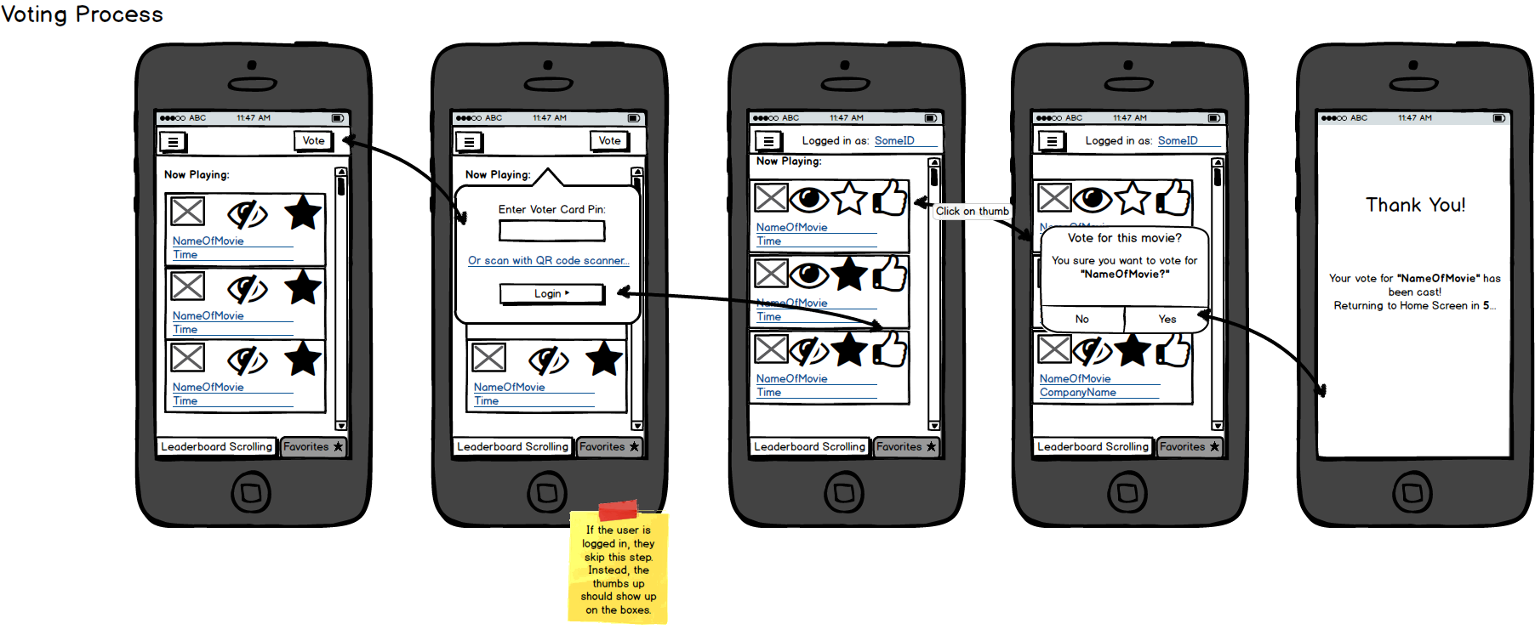









World Arts Film Festival e-Voting System
Full name, ECT
University of North Florida, College Jacksonville, FL USA 32224
WORLD ART FILM FESTIVAL
DEVELOPMENT STORY
SUMMARY
Next year 5,000 attendees are expected to benefit from participating in the World Arts Film Festival including college-aged students, local and visiting filmmakers from over 30+ countries, men and women from Jacksonville area, New York and California, groups, families and individuals including those with special needs interested in the unique film festival experience.
Our e-Voting system will allow visitors to vote on films and give feedback from a kiosk or from their mobile phone.
Our client would like to recognize the filmmakers for their hard work because they currently don’t have any system in place to recognize the collaborative efforts of the production crew.
USER STORIES
FUTURE
In our e-Voting System we have accumulated roughly 40 different use r stories so far. All of these user stories revolves around 3 actors; Voter, Admin, Mobile Voter. Below is a snippet of just a couple of the user stories we came up with.
MOBILE DEVELOPMENT
With our system the client will be able to provide real-time feedback, with a voting leaderboard and allow greater functionality for planning future film festival events within a simple software package.

